Slide 1

HOUSING: PRICE PREDICTION
14-04-2022
Internship-24
Presented by: Ram kumar

Slide 2
Acknowledgement
Data Science with ML
SME -Khushoo Garg
Flip Robo Technology

Slide 3
What is HOUSING PRICE PREDICTION?
Houses are one of the necessary need of each and every person around the globe and therefore housing and real estate.
House price prediction can help the developer determine the selling price of a house and can help the customer to arrange the right time to purchase a house.
influence the price of a house which include physical conditions, concept and location. House Price prediction, is important to drive Real Estate efficiency. As earlier, House prices were determined by calculating the acquiring and selling price in a locality.

Slide 4
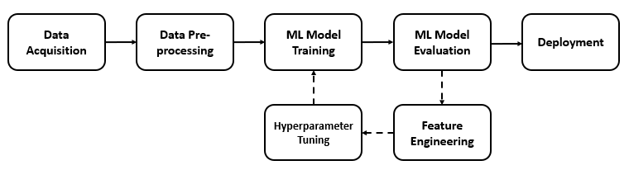
HOUSING: PRICE PREDICTION Diagram:

Slide 5
Visualization of HOUSING PRICE PREDICTION

Slide 6
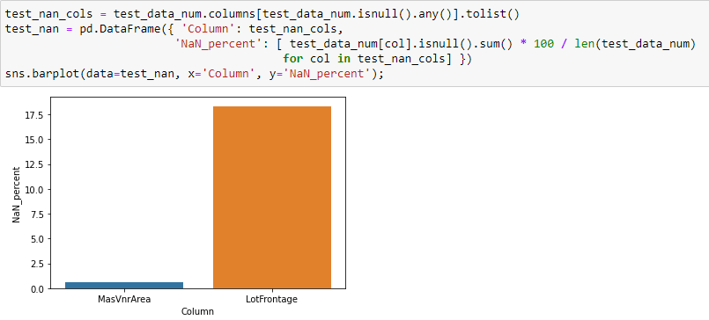
Graphs:
This barplot gives numbers of counts and showing that which masvnr area is more interesting.
.

Slide 7
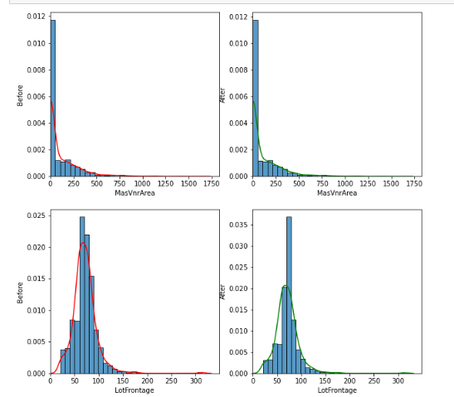
Graphs:
From this barplot we analysis that before filling NaN and after filling NaN

Slide 8
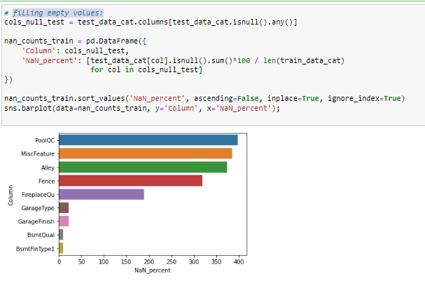
Graphs:
Here Showing filling empty values.

Slide 9
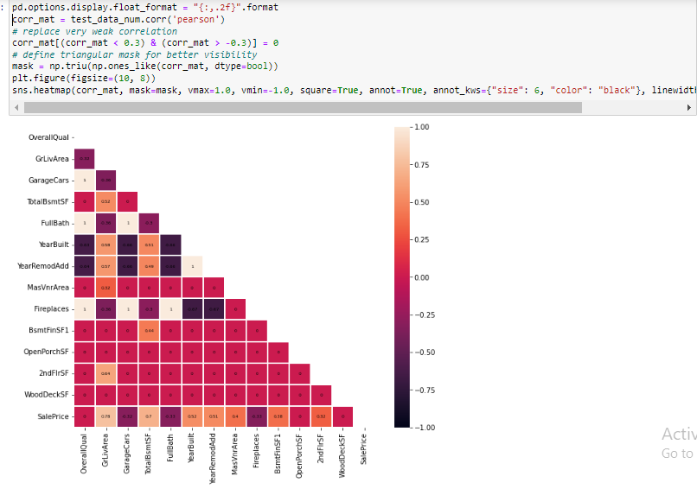
Graphs:

Slide 10
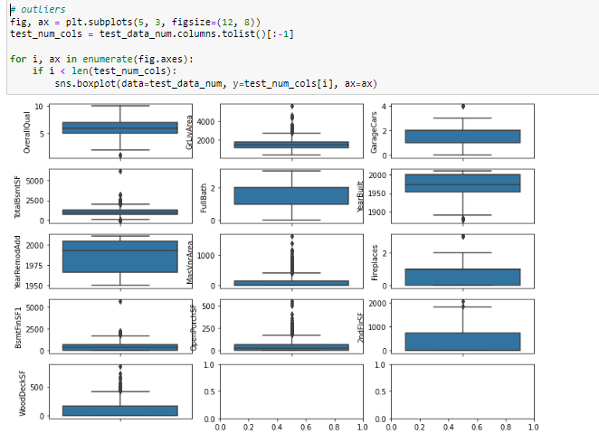
Graphs:

Slide 11
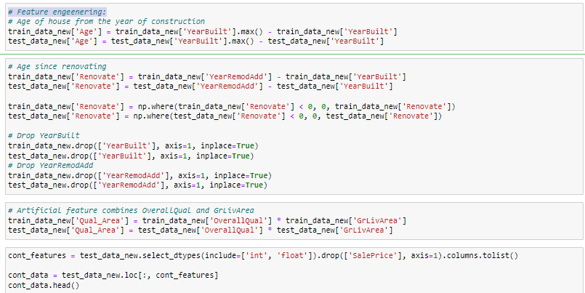
Feature engeenering

Slide 12
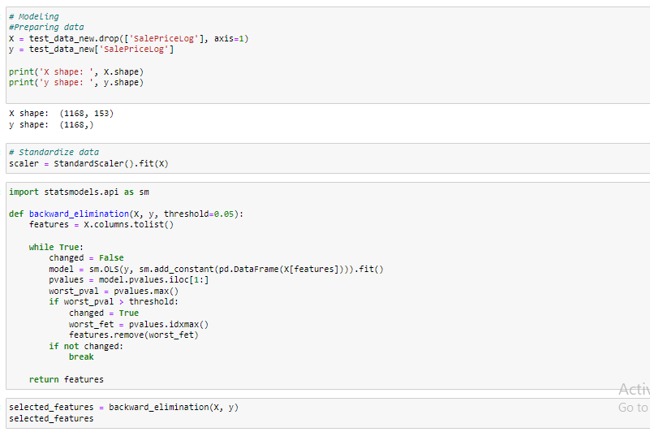
Testing of Identified Approaches (Algorithms):
.

Slide 13
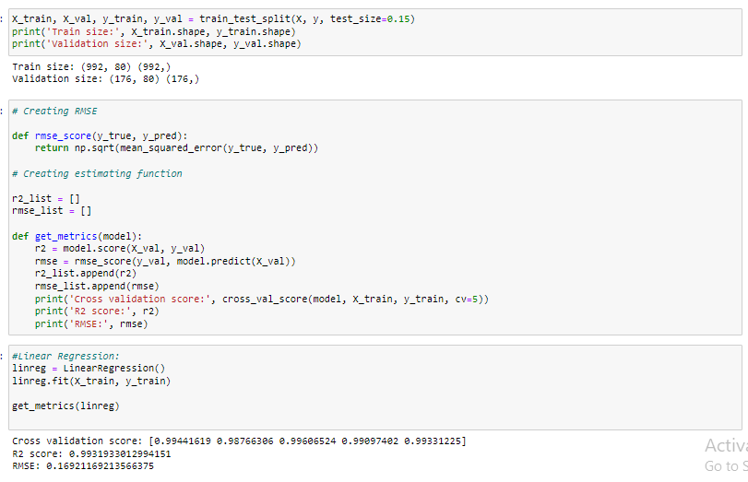
Run and Evaluate selected models

Slide 14
Run and Evaluate selected models

Slide 15
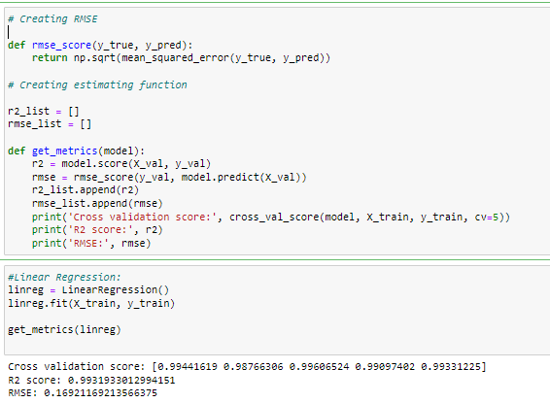
Creating RMSE:

Slide 16
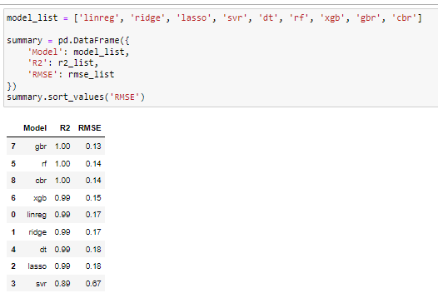
Interpretation of the Results

Slide 17
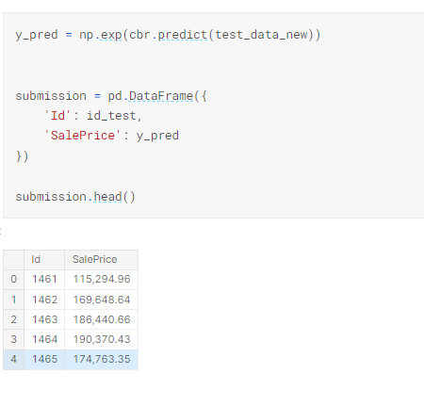
Prediction of dataset:

Slide 18
CONCLUSION :
This Kernel investigates different models for housing price prediction. Different types of Machine Learning methods including CatBoostRegressor, GradientBoostingRegressor and LightGBM and two techniques in machine learning are compared and analyzed for optimal solutions. Eventhough all of those methods achieved desirable results, different models have their own pros and cons.
The GradientBoostingRegressor is probably the best one and has been selected for this problem. The BayesianOptimization method is simple but performsa lot better than the three other availabel methods due to the generalization.
Finally, the CatBoostRegressor is the best choice when parametrerization is the top priority.

